Slide 1
The Principle of Relatedness Local & Global Knowledge Sourcing Pierre-Alexandre Balland

Slide 2


Slide 3


Slide 4
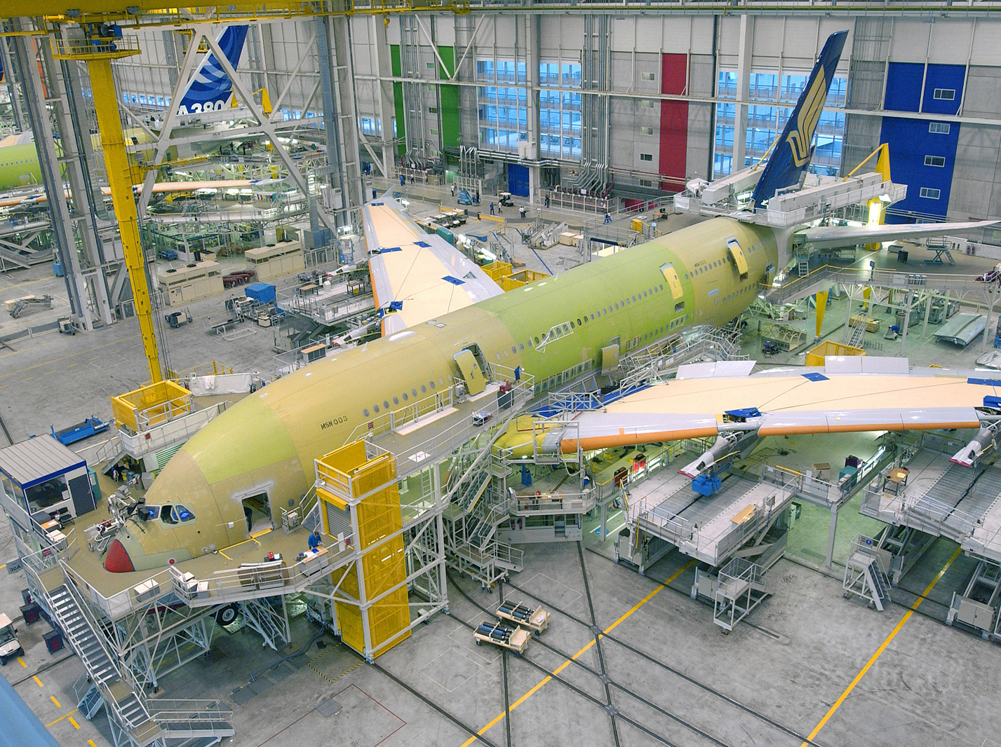

Slide 5
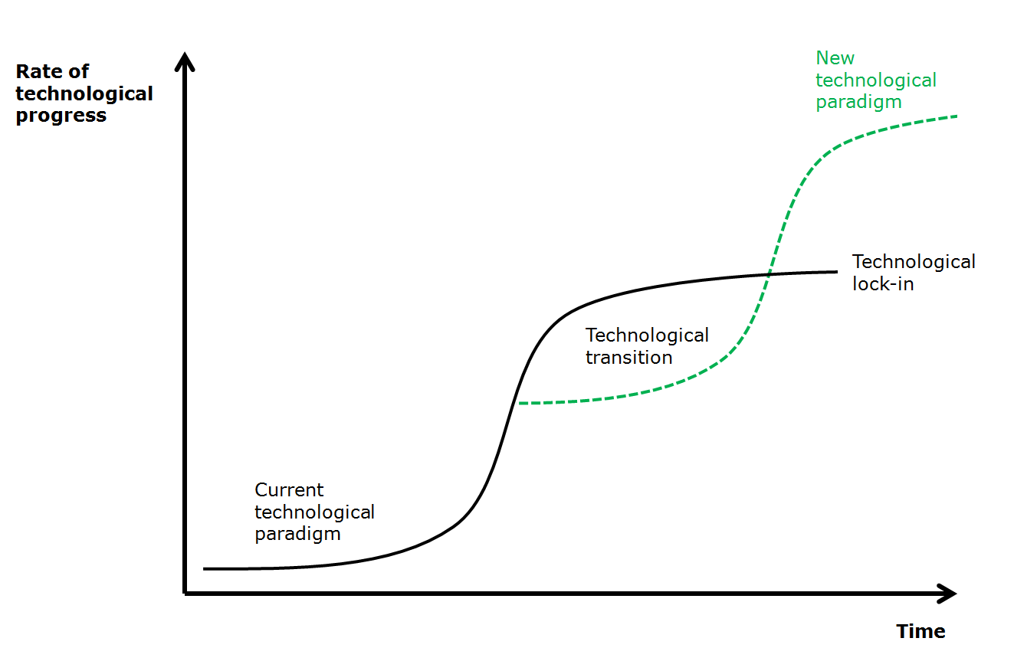

Slide 6
Key issues
Regions need to continuously re-invent themselves to secure long run prosperity

Slide 7
Key issues
Regions need to continuously re-invent themselves to secure long run prosperity
Identify diversification opportunities that upgrade the regional economy

Slide 8
Key issues
Regions need to continuously re-invent themselves to secure long run prosperity
Identify diversification opportunities that upgrade the regional economy
By building on local capabilities (internal relatedness)

Slide 9
Key issues
Regions need to continuously re-invent themselves to secure long run prosperity
Identify diversification opportunities that upgrade the regional economy
By building on local capabilities (internal relatedness)
By connecting to regions that have complementary capabilities (external relatedness)

Slide 10
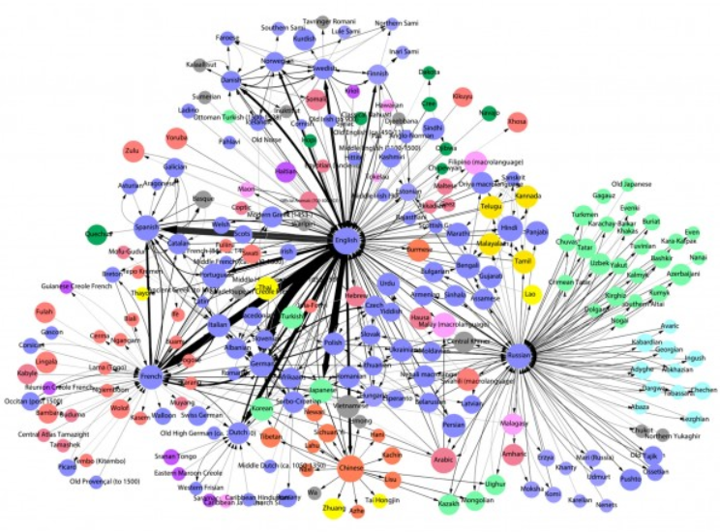
Most influential languages

Slide 11
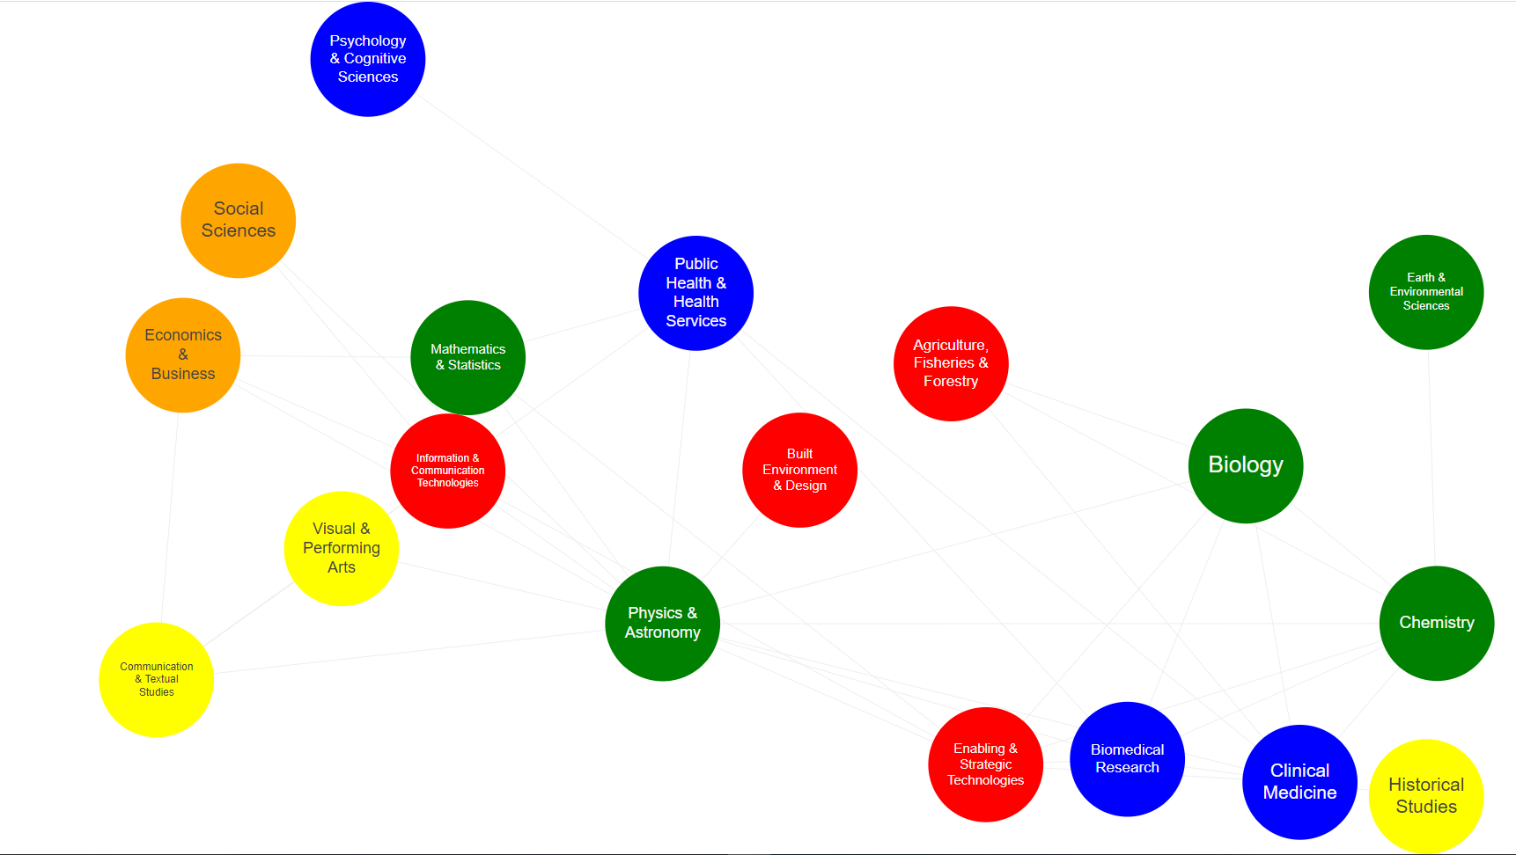
Relatedness & the knowledge space
Notes:
https://www.paballand.com/asg/dg-regio/nov-13/rel-science-patents-co-class.html
https://www.paballand.com/asg/dg-regio/nov-13/rel-science-publications.html

Slide 12
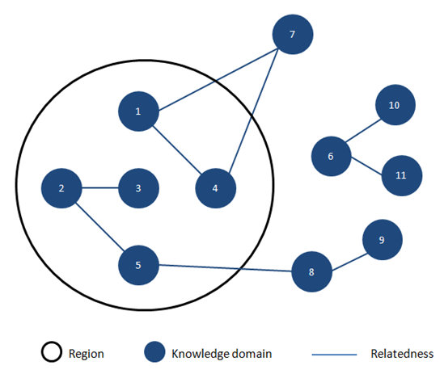
Regional knowledge structure

Slide 13
The density of related technologies
City | Technology | Density (%)
Ile de France | Biotech | 10
Ile de France | Nanotech | 100
Rhone Alpes | Biotech | 80
Rhone Alpes | Nanotech | 0
… | … | …
The Density Index indicates how close a potential new technology is to the knowledge bases of a given city

Slide 14
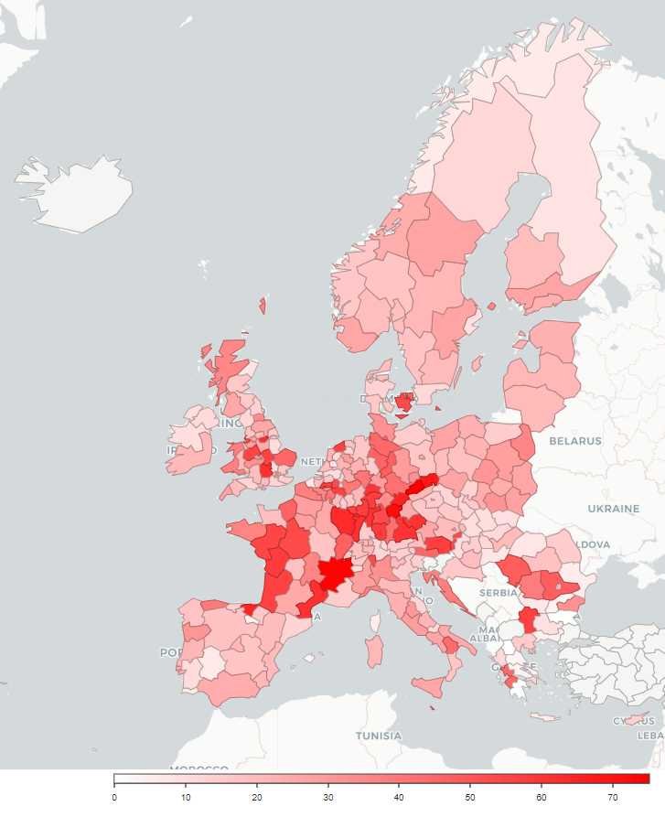
European hubs in battery technologies

Slide 15
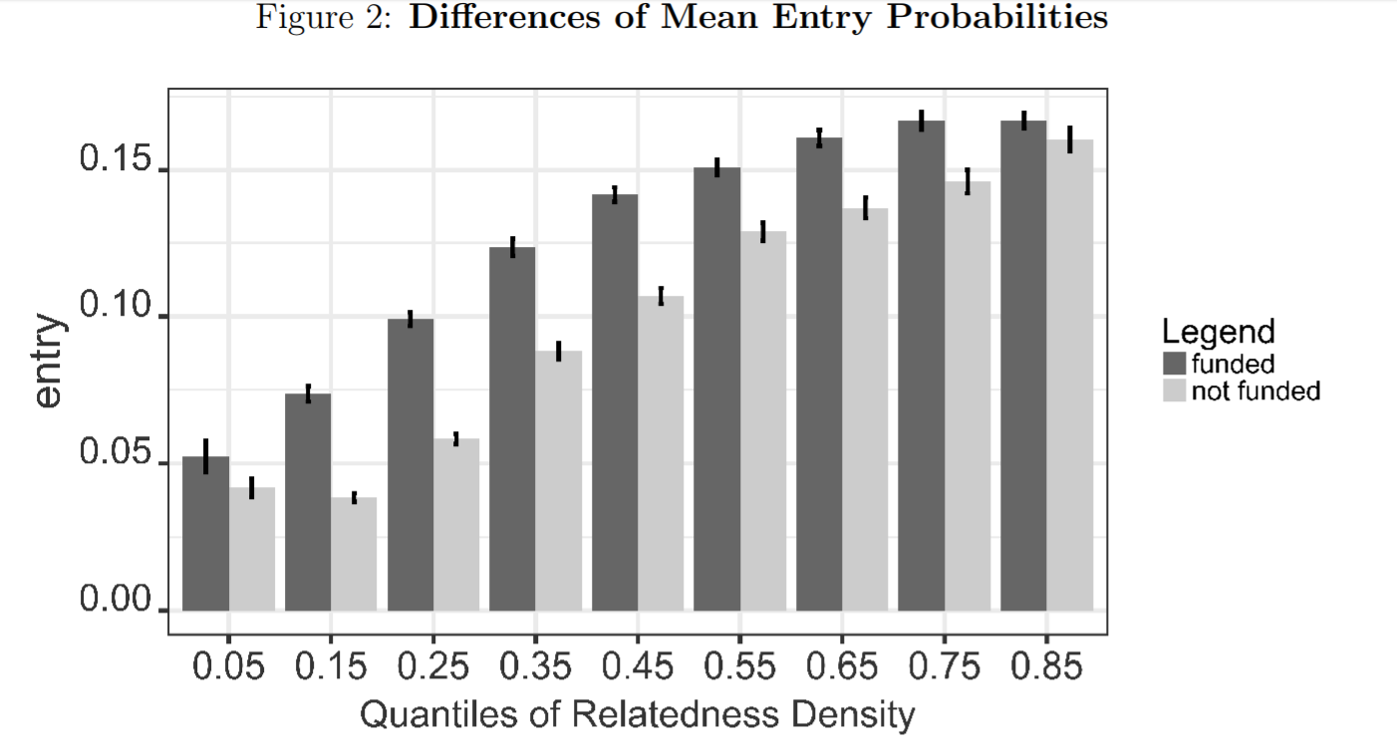
Uhlbach et al. (2017)

Slide 16

Video 1
Video 2
We build recommendation systems to guide investment decisions in cities
Cust. 1
Cust. 2

Slide 17
Tech 1
Tech 2
We build recommendation systems to guide investment decisions in cities
City 1
City 2

Slide 18
Evidence-based framework for S3
Complexity
Nanotech
Biotech
Relatedness
Balland, P. A., Boschma, R., Crespo, J., & Rigby, D. L. (2019). Smart specialization policy in the European Union: relatedness, knowledge complexity and regional diversification. Regional Studies, 53(9), 1252-1268.

Slide 19
Evidence-based framework for S3
Complexity
High Risks
High Benefits
Low Risks
High Benefits
High Risks
Low Benefits
Low Risks
Low Benefits
Relatedness
Balland, P. A., Boschma, R., Crespo, J., & Rigby, D. L. (2019). Smart specialization policy in the European Union: relatedness, knowledge complexity and regional diversification. Regional Studies, 53(9), 1252-1268.

Slide 20
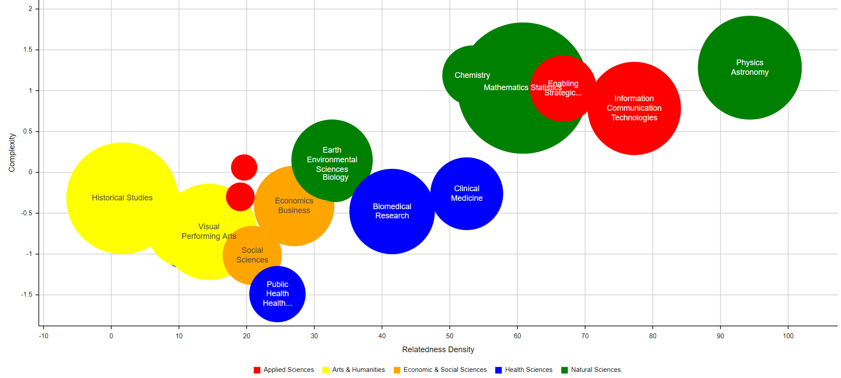
S3 framework (FR10)

Slide 21
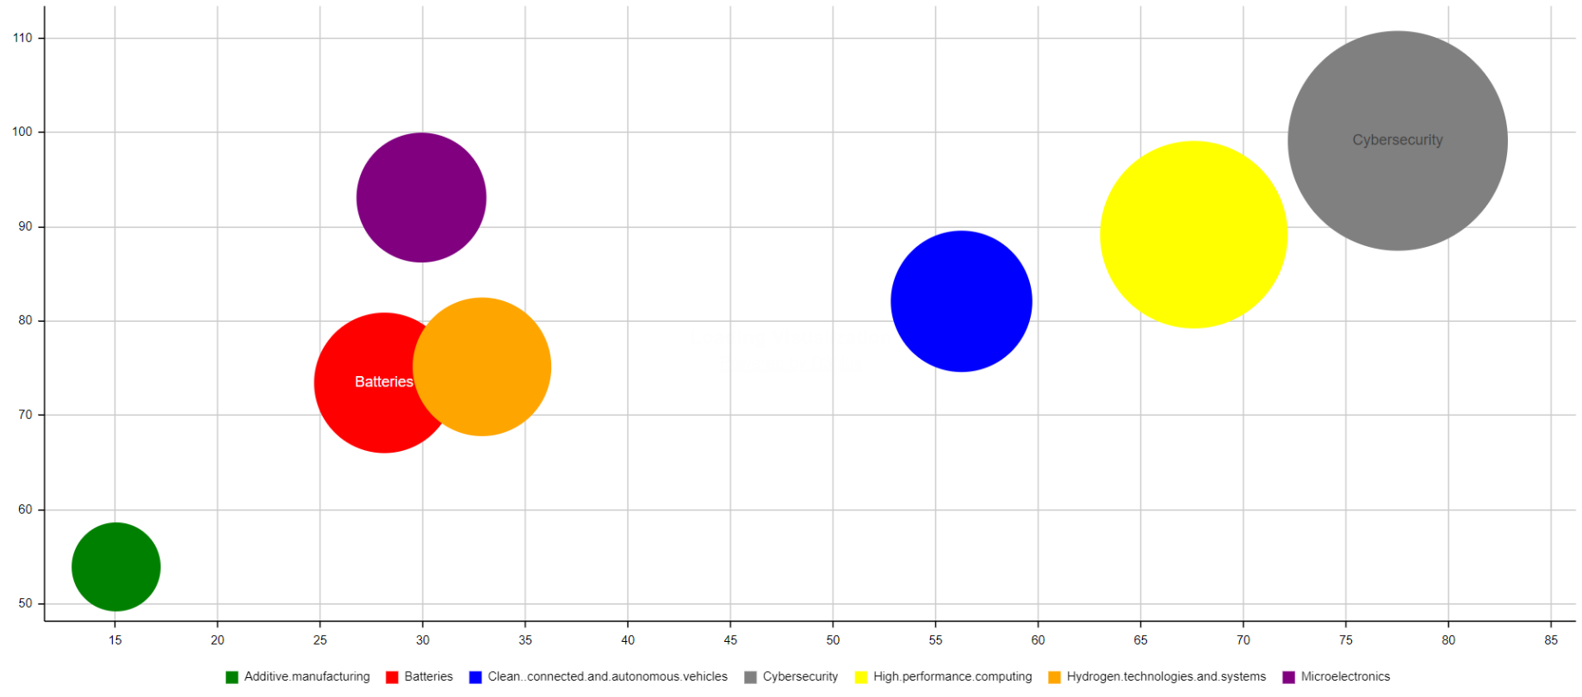
Ile de France opportunities in 7 key techs
Complexity
Relatedness

Slide 22
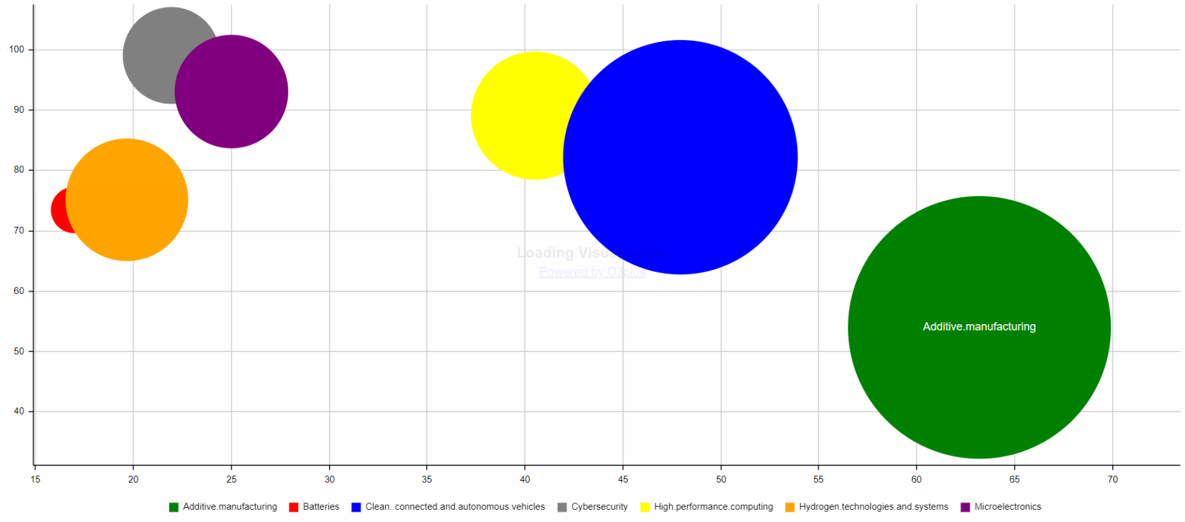
Lancashire opportunities in 7 key techs
Complexity
Relatedness

Slide 23
Beyond local capabilities
Local capabilities are key but so are external linkages
Balland and Boschma (2019) show that regions that collaborate with complementary regions more likely to develop successful specializations
A key issue to identify the right regions as strategic partners as part of S3
Strategic partners not just any regions but the ones that can provide missing capabilities

Slide 24
How to find strategic partners?
Added Relatedness
Technology i
Region C
(+ 50%)
Region B
(+ 30%)
Distance

